Slide 1
K-Means Clustering
What it is?
python implementation
Use cases

Slide 2
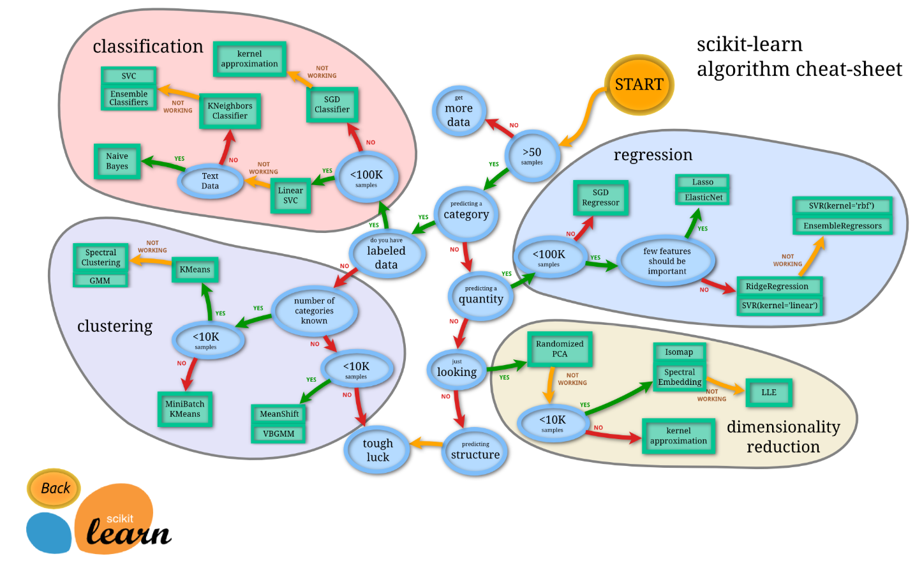
Scikit-learn – cheat sheet

Slide 3
What it is
K-means clustering is a simple unsupervised learning algorithm that is used to group/ cluster n objects based on certain attributes into k partitions, where k < n.
Follows a simple procedure of classifying a given data set into a number of clusters, defined by the letter "k," which is fixed beforehand.
Groups data using a “top-down” approach since it starts with a predefined number of clusters and assigns all observations to each of them.
no overlaps in the groups; each observation is assigned only to a single group.
Approach is computationally faster and can handle greater numbers of observations than agglomerative hierarchical clustering
K-means clustering has uses in search engines, market segmentation, statistics and even astronomy.

Slide 4
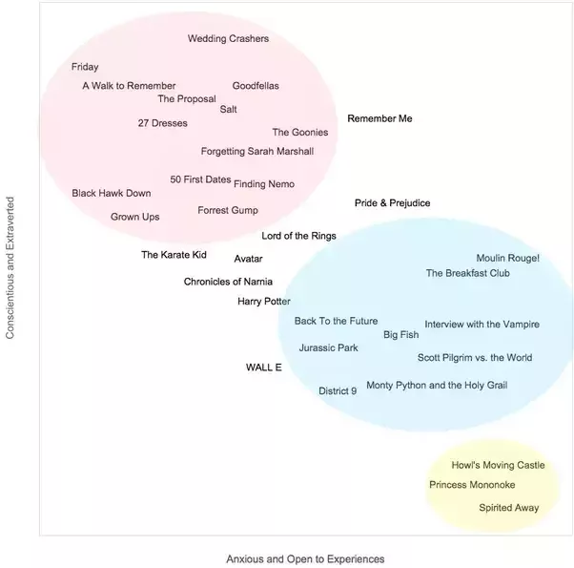
Example
Different movie genres appeal to people of different personalities. To confirm this, construct a plot of movie titles along personality dimensions:
There appears to be 3 clusters:
Red: Conscientious extraverts who like action and romance genres
Blue: Anxious and open people who like advant-garde and fantasy genres
Yellow: Introverts with social anxieties who like Japanese animations (otaku culture)
Movies in the center seem to be general household favorites.

Slide 5
K-Means Algorithm Properties
There are always K clusters.
There is always at least one item in each cluster.
The clusters are non-hierarchical and they do not overlap.
Every member of a cluster is closer to its cluster than any other cluster

Slide 6
The K-Means Algorithm Process
The dataset is partitioned into K clusters and the data points are randomly assigned to the clusters.
For each data point:
  Calculate the distance from the data point to each cluster.
  If the data point is closest to its own cluster, leave it where it is. If the data point is not closest to its own cluster, move it into the closest cluster.
  Repeat the above step until a complete pass through all the data points results in no data point moving from one cluster to another. At this point the clusters are stable and the clustering process ends.
  The choice of initial partition can greatly affect the final clusters that result, in terms of inter-cluster and intra-cluster distances

Slide 7
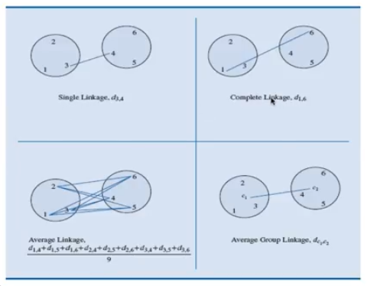
Proximity between clusters
Single Linkage - Distance between two nearest patterns in the clusters
Complete Linkage - Distance between 2 farthest data patterns
Average Linkage –
Average Group (centroid) linkage –

Slide 8

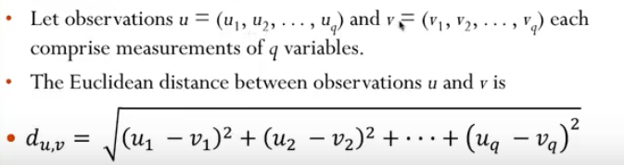
Distance calculation
The Euclidean distance function measures the ‘as-the-crow-flies’ distance. The formula for this distance between a point X (X1, X2, etc.) and a point Y (Y1, Y2, etc.) is:

Slide 9
How it works
Group the data points into 3 clusters
Randomly decide on starting center points of the 3 clusters

Slide 10
How it works
Initial centroid assigned (randomly)
Distance calculation using rectilinear method and assignment of cluster based on min distance
New centroid for each cluster calculated (averaging of data points)

Slide 11
How it works
Centroid adjusted from previous iteration
Distance calculation using rectilinear method and assignment of cluster based on min distance
New centroid for each cluster calculated (averaging of data points)

Slide 12
How it works
Centroid adjusted from previous iteration
Distance calculation using rectilinear method and assignment of cluster based on min distance
No change in the cluster assignment, Hence STOP
New centroid for each cluster calculated (averaging of data points)

Slide 13
Practical Applications
Customer Segmentation:
Pricing Segmentation
Loyalty
Spend Behaviour
Branch Geo
Customer Need | needs, channel of preferences, service expectations.
Category | Who are these customers? Why are they behaving the way to?
Customer Service | Customer Value in last 6/12/18/24 months Customer Type – Individuals and Small Businesses Product type (e.g. Gas, Electricity etc) Length of Relationship Overall consumption Number of complains
News Article Clustering

Slide 14
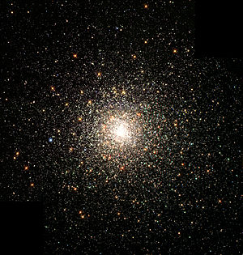
Disadvantages
Fixed number of clusters can make it difficult to predict what K should be.
Does not work well with non-globular clusters.
Different initial partitions can result in different final clusters.
Even outliers become part of some cluster!
A Globular clusters are very tightly bound, which gives them their spherical shapes and relatively high stellar densities toward their centers.

Slide 15
When K-Means Clustering Fails
(-) Real-life data is almost always messy.
(-) The examples and illustrations we see in our statistics courses are designed to reflect ideal situations that sadly almost never occur in the real world.
(+) This works best when your data is roughly "spherical," as in the toy data set
(+) Still the most widely used unsupervised machine learning algorithms

Slide 16
Use cases
Behavioral segmentation | Inventory categorization | Sorting sensor measurements | Detecting bots or anomalies
Segment by purchase history Segment by activities on application, website, or platform Define personas based on interests Create profiles based on activity monitoring | Group inventory by sales activity Group inventory by manufacturing metrics | Detect activity types in motion sensors Group images Separate audio Identify groups in health monitoring | Separate valid activity groups from bots Group valid activity to clean up outlier detection

Slide 17
Kmeans – scitkit learn
KMeans(n_clusters=8, init=’k-means++’, n_init=10, max_iter=300, tol=0.0001, precompute_distances=’auto’, verbose=0, random_state=None, copy_x=True, n_jobs=None, algorithm=’auto’)[source]
Attributes:
  cluster_centers_ : array, [n_clusters, n_features] Coordinates of cluster centers. If the algorithm stops before fully converging
  labels_ : Labels of each point
  inertia_ : float, Sum of squared distances of samples to their closest cluster center.
  n_iter_ : int, Number of iterations run.

Slide 18
Specifying different distance calculation method
SCITKIT learn implementation only supports ‘Euclidean’ distance measure
Along with K-means there are some algorithms like
  K-means++
  K-mediods
  K-medians

Slide 19
K-means++
The exact algorithm is as follows:
Choose one center uniformly at random among the data points.
For each data point x not chosen yet, compute D(x), the distance between x and the nearest center that has already been chosen.
Choose one new data point at random as a new center, using a weighted probability distribution where a point x is chosen with probability proportional to D(x)².
Repeat Steps 2 and 3 until k centers have been chosen.
Now that the initial centers have been chosen, proceed using standard k-means clustering.

Slide 20
K-medoids
The k-medoids problem is a clustering problem similar to k-means. Both the k-means and k-medoids algorithms are partitional (breaking the dataset up into groups) and attempt to minimize the distance between points labeled to be in a cluster and a point designated as the center of that cluster. In contrast to the k-means algorithm, k-medoids chooses actual data points as centers (medoids or exemplars), and thereby allows for greater interpretability of the cluster centers than in k-means, where the center of a cluster is not necessarily one of the input data points (it is the average between the points in the cluster). Furthermore, k-medoids can be used with arbitrary dissimilarity measures, whereas k-means generally requires Euclidean distance for efficient solutions. Because k-medoids minimizes a sum of pairwise dissimilarities instead of a sum of squared Euclidean distances, it is more robust to noise and outliers than k-means.
k-medoids is a classical partitioning technique of clustering that splits the data set of n objects into k clusters, where the number k of clusters assumed known a priori (which implies that the programmer must specify k before the execution of a k-medoids algorithm). The "goodness" of the given value of k can be assessed with methods such as the silhouette method.

Slide 21
K-medoids
PAM uses a greedy search which may not find the optimum solution, but it is faster than exhaustive search. It works as follows:
(BUILD) Initialize: greedily select k of the n data points as the medoids to minimize the cost
Associate each data point to the closest medoid.
(SWAP) While the cost of the configuration decreases:
  For each medoid m, and for each non-medoid data point o:
    Consider the swap of m and o, and compute the cost change
    If the cost change is the current best, remember this m and o combination
  Perform the best swap of {\displaystyle m_{\text{best}}} and {\displaystyle o_{\text{best}}}, if it decreases the cost function. Otherwise, the algorithm terminates.

Slide 22
K-medians
The median is computed in each single dimension in the Manhattan-distance formulation of the k-medians problem, so the individual attributes will come from the dataset. This makes the algorithm more reliable for discrete or even binary data sets. In contrast, the use of means or Euclidean-distance medians will not necessarily yield individual attributes from the dataset. Even with the Manhattan-distance formulation, the individual attributes may come from different instances in the dataset; thus, the resulting median may not be a member of the input dataset.
This algorithm is often confused with the k-medoids algorithm. However, a medoid has to be an actual instance from the dataset, while for the multivariate Manhattan-distance median this only holds for single attribute values. The actual median can thus be a combination of multiple instances. For example, given the vectors (0,1), (1,0) and (2,2), the Manhattan-distance median is (1,1), which does not exist in the original data, and thus cannot be a medoid.
In statistics, k-medians clustering^{[1][2]} is a cluster analysis algorithm. It is a variation of k-means clustering where instead of calculating the mean for each cluster to determine its centroid, one instead calculates the median. This has the effect of minimizing error over all clusters with respect to the 1-norm distance metric, as opposed to the squared 2-norm distance metric (which k-means does.)

